Slide 1
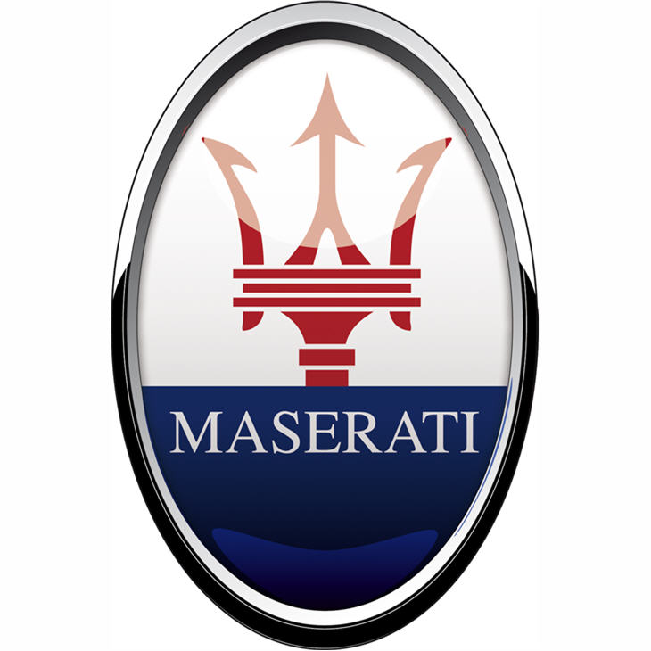
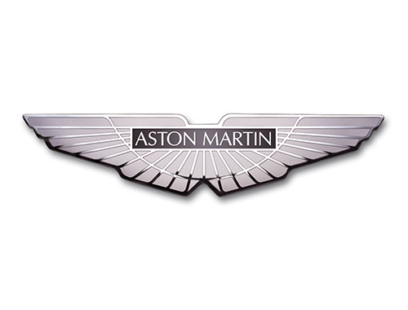
Comparison of Maserati S.p.A. and Aston Martin Lagonda
A. Zaitsev, V. Gutnik

Slide 2
PLAN:
Quick review of the Maserati and Aston Martin
History, current development and future plans
Conclusion

Slide 3
QUICK REVIEW OF THE COMPANIES

Slide 4
Maserati S.p.A.

Slide 5
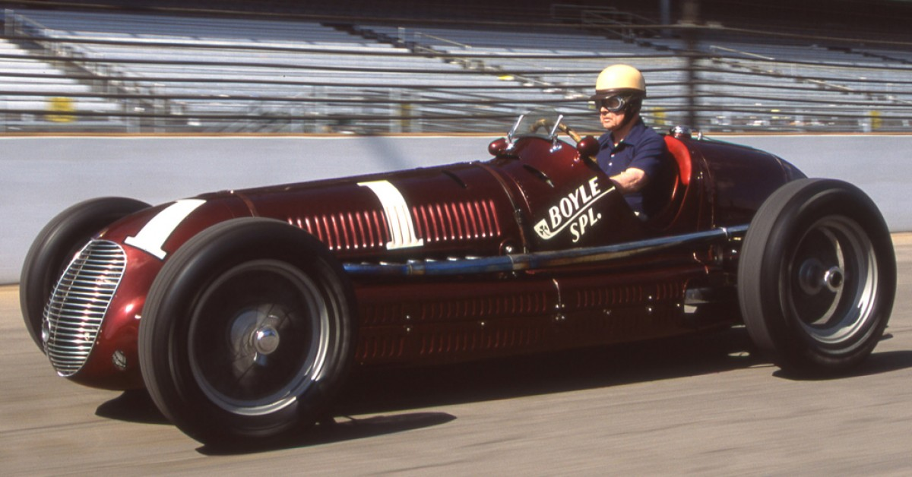
Maserati on Indianapolis 500, 1939

Slide 6
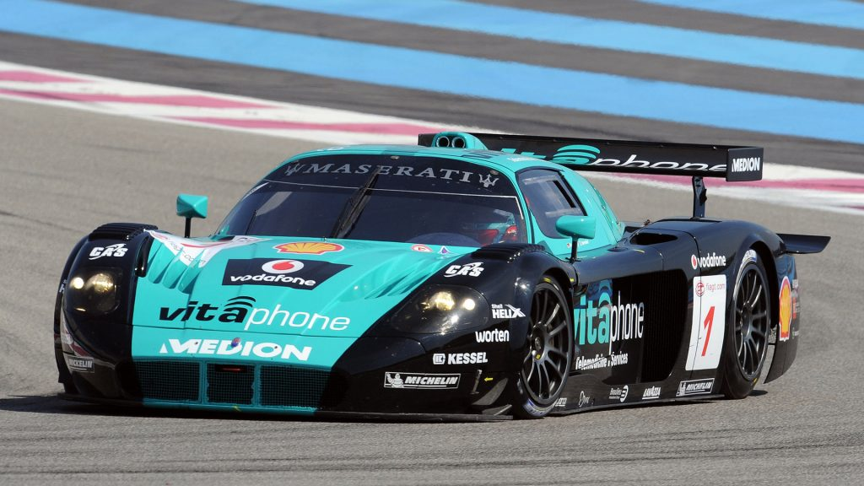
Maserati MC12 GT1 on track, 2005

Slide 7
Aston Martin Lagonda Limited

Slide 8
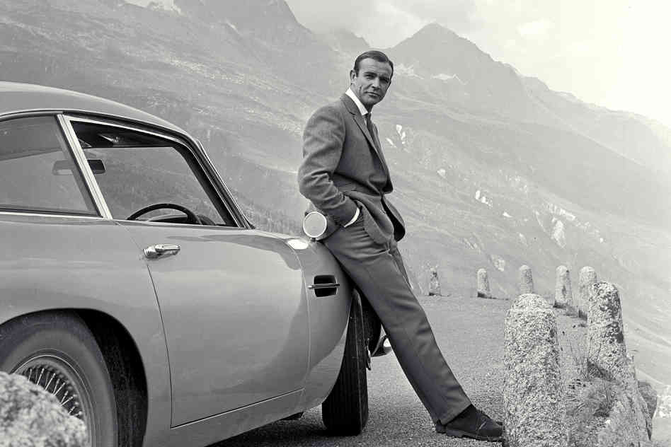
James Bond leaning against DB5

Slide 9
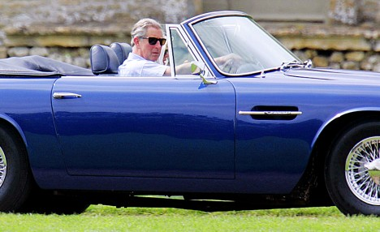
Prince Charles in his Aston Martin

Slide 10
HISTORY

Slide 11
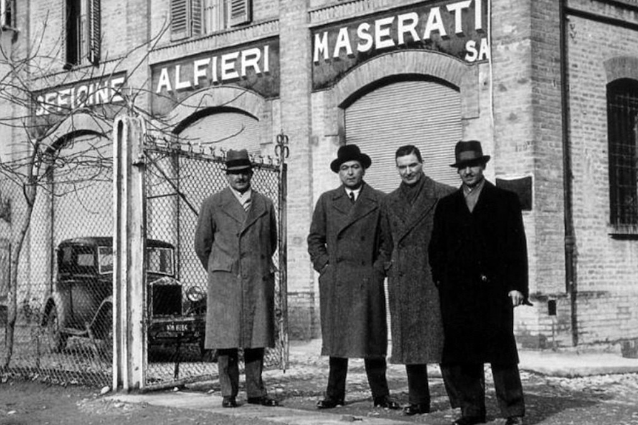
Alfieri brothers, founders, near first Maserati office

Slide 12
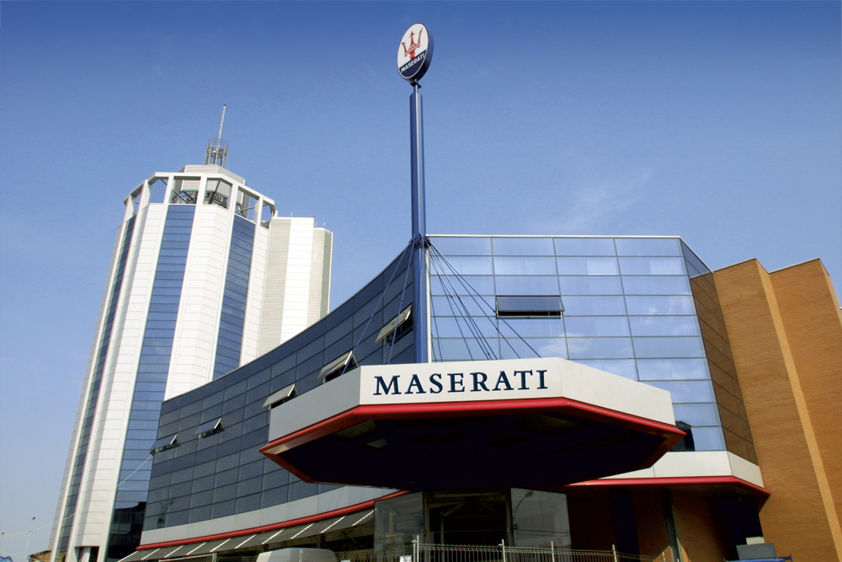
Modern HQ of Maserati

Slide 13
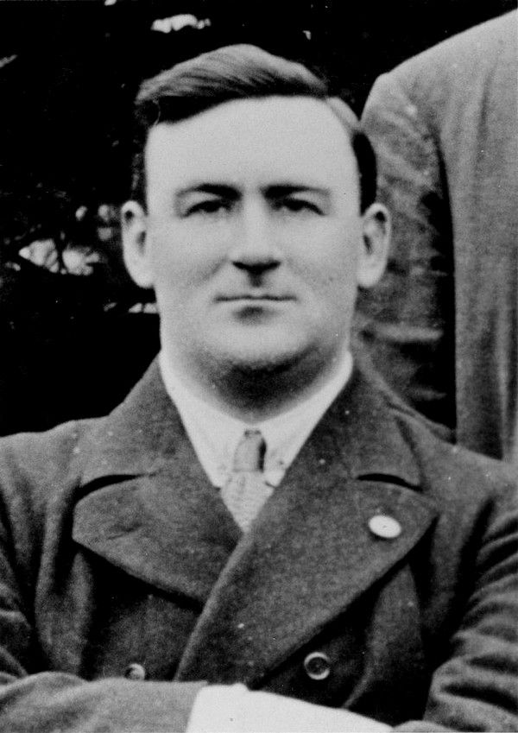
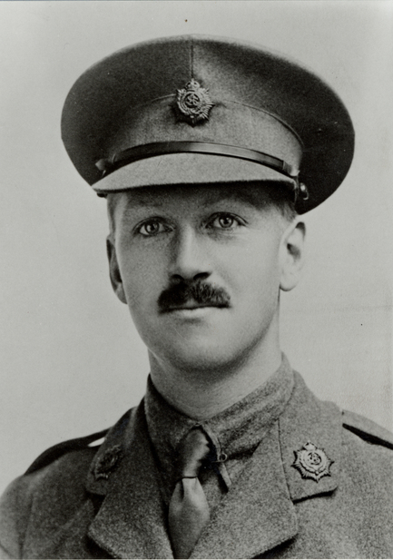
Founders of Aston Martin
LIONEL MARTIN 1878-1945
ROBERT BAMFORD 1883-1942

Slide 14
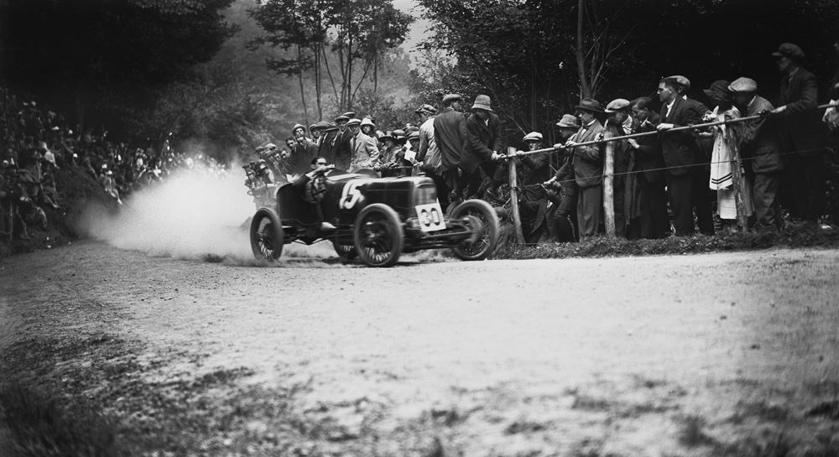
One of the first Martin’s in the race, 1922

Slide 15
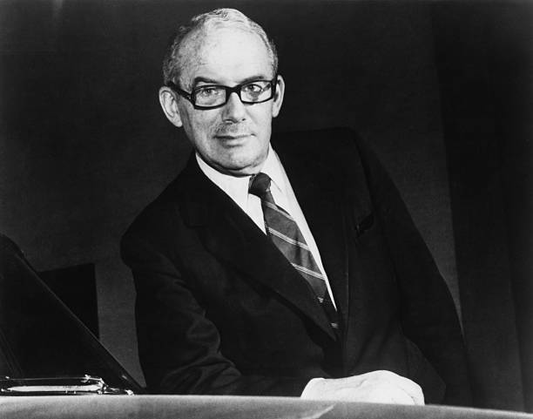
David Brown, owner of Aston Martin, 1947-1972

Slide 16
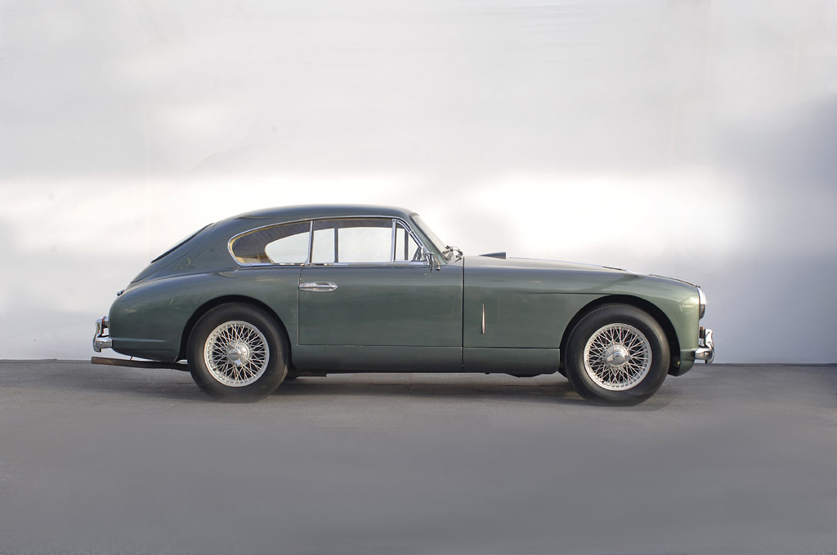
DB2, 1950

Slide 17

Owned 75% of Aston Martin in 1987, 100% in 1993

Slide 18

Bought AM for 475000000 £ in 2007

Slide 19

Bought 5% of AM in 2013

Slide 20
COMPANYS’ OBJECTIVES

Slide 21
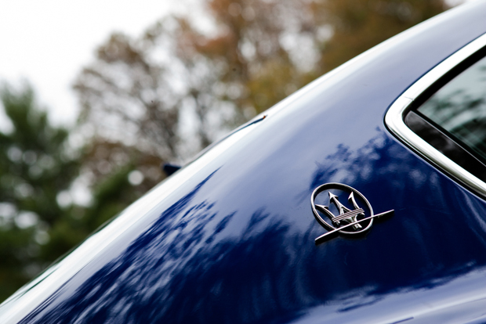
Maserati objectives
Luxury, sports and style cast in exclusive cars

Slide 22
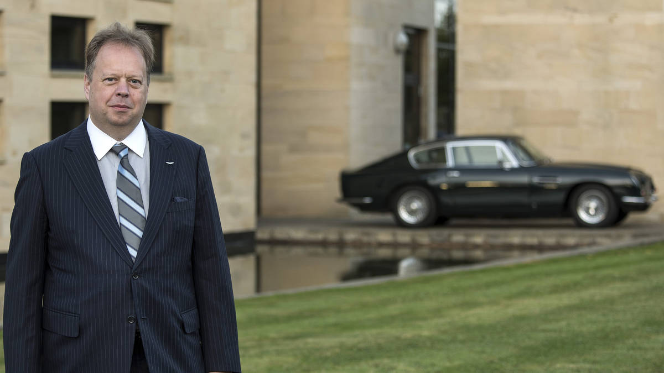
Aston Martin objectives
Andrew Palmer, CEO of Aston Martin
Sustainable luxury business

Slide 23
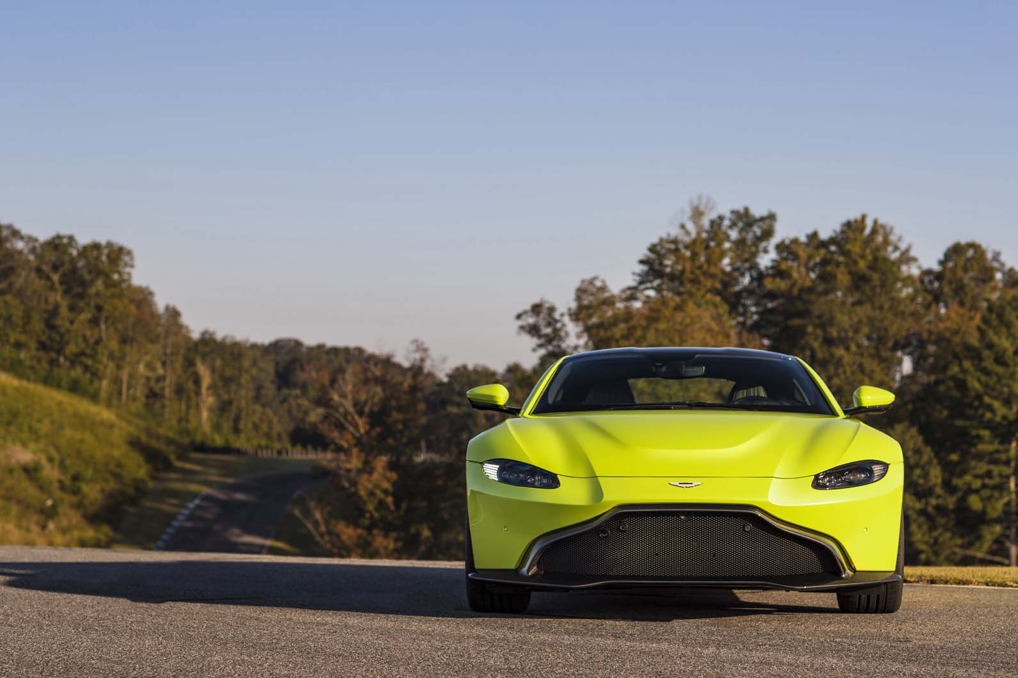
“Environmental performance of Aston Martin is at the heart”

Slide 24
TYPES OF PRODUCTS

Slide 25
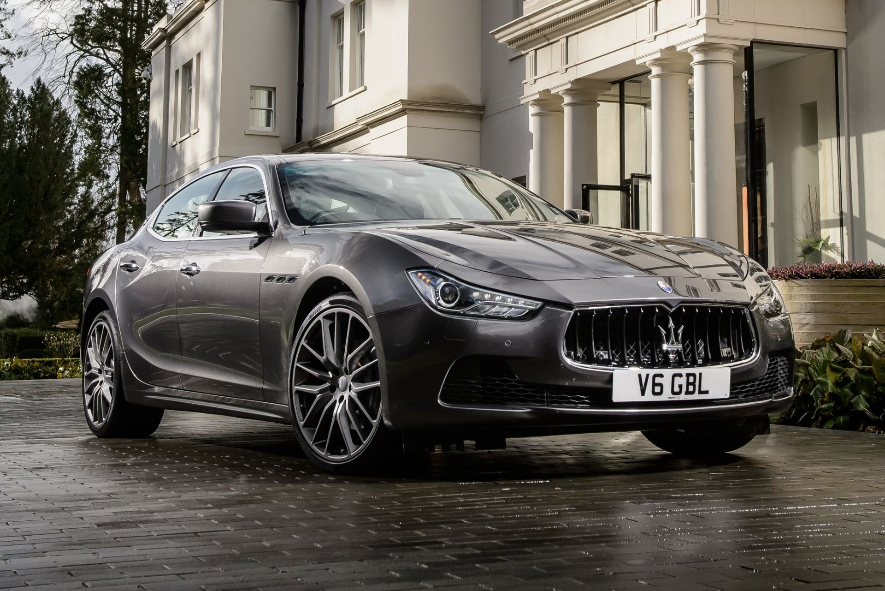
Maserati Ghibli

Slide 26
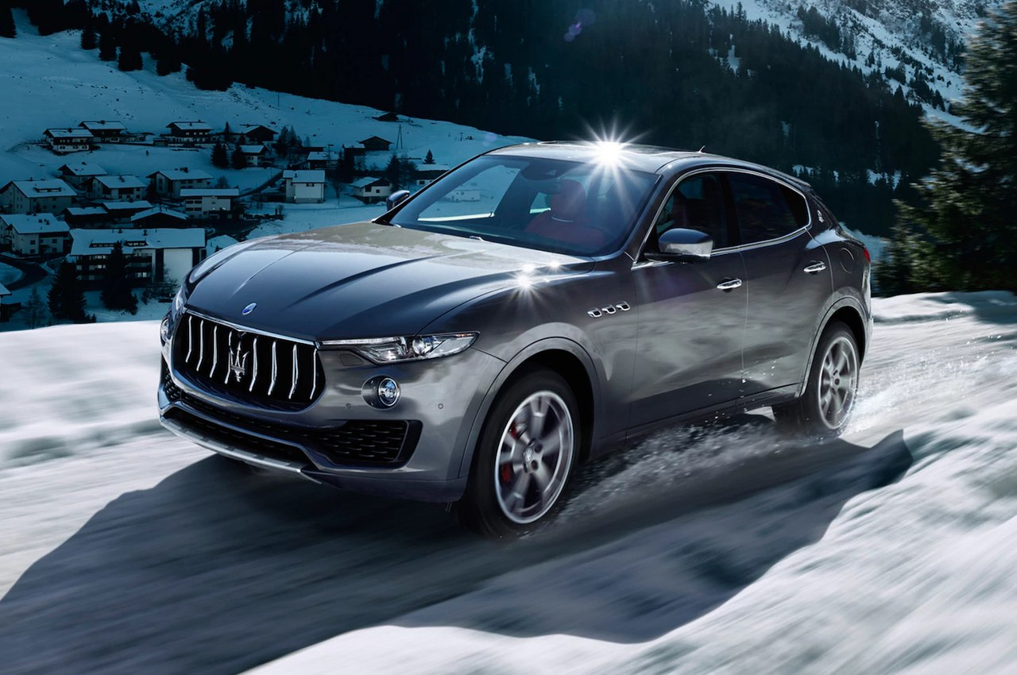
Maserati Levante

Slide 27
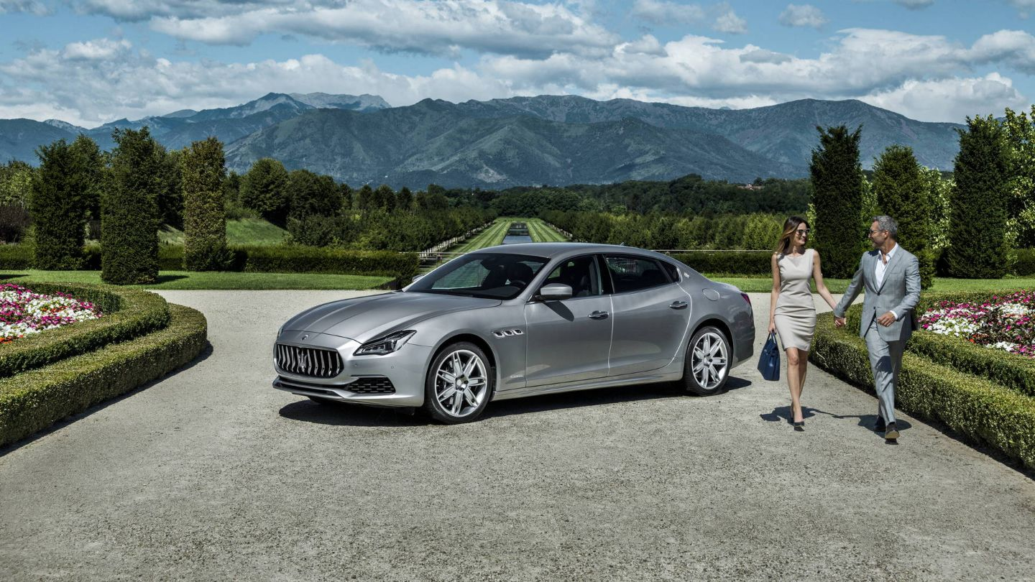
Maserati Quattroporte

Slide 28
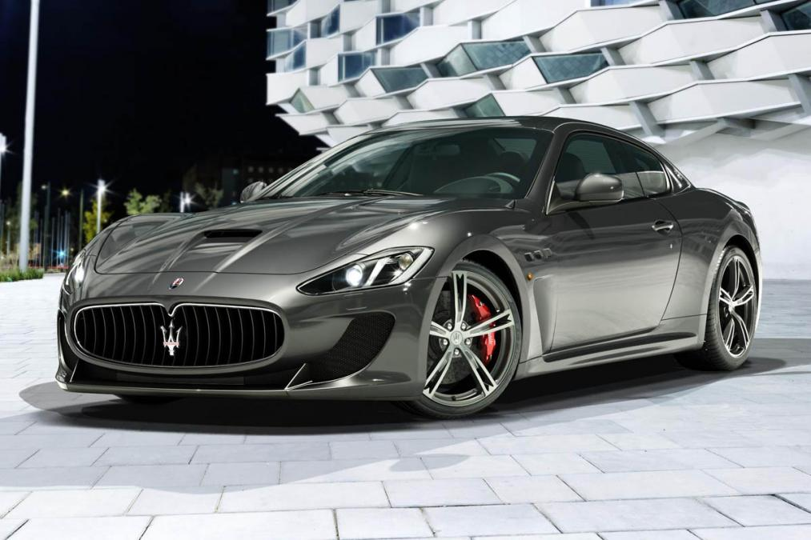
Maserati Gran Turismo

Slide 29
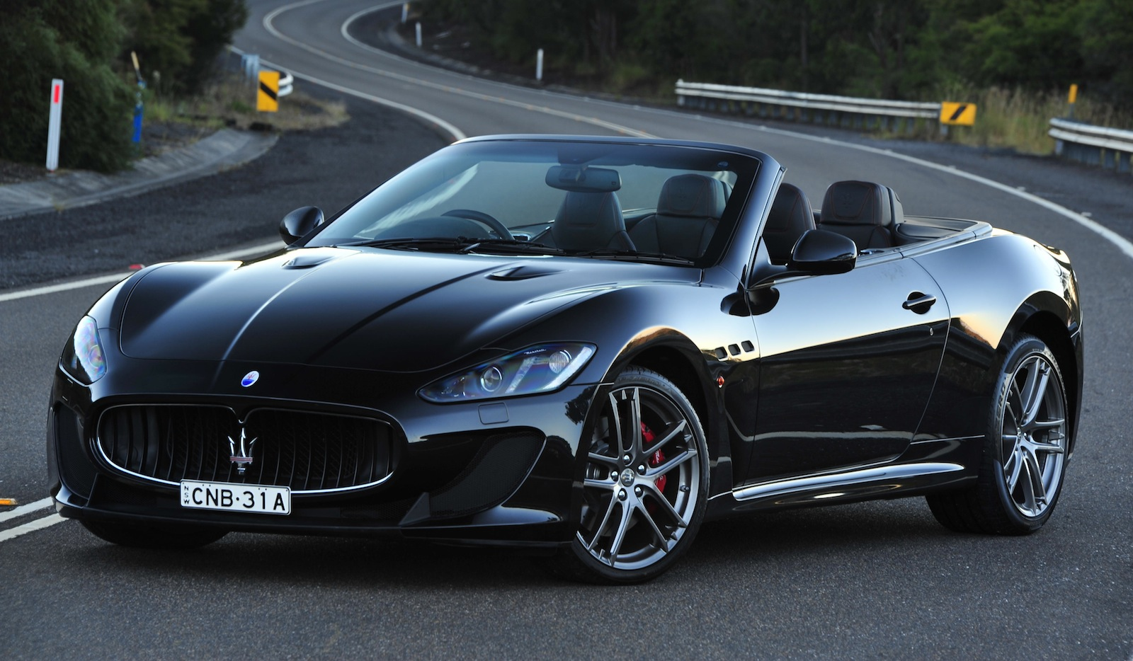
Maserati Gran Cabrio

Slide 30
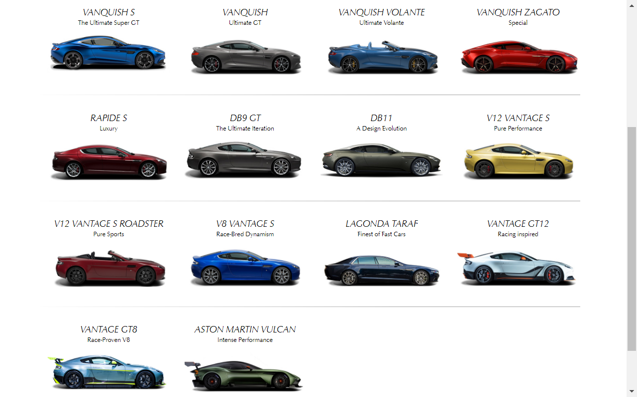
Aston Martin’s current range

Slide 31
LOGO AND SLOGAN

Slide 32
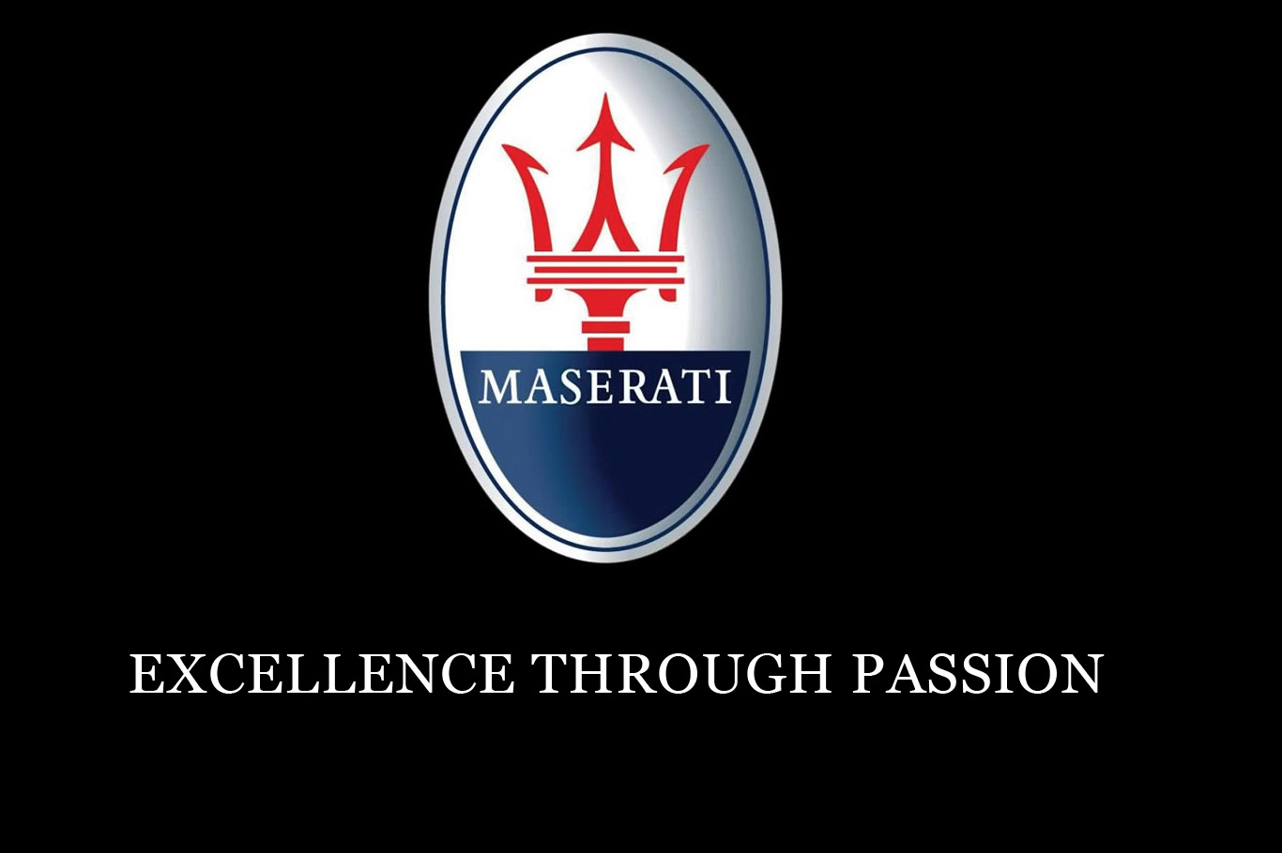

Slide 33
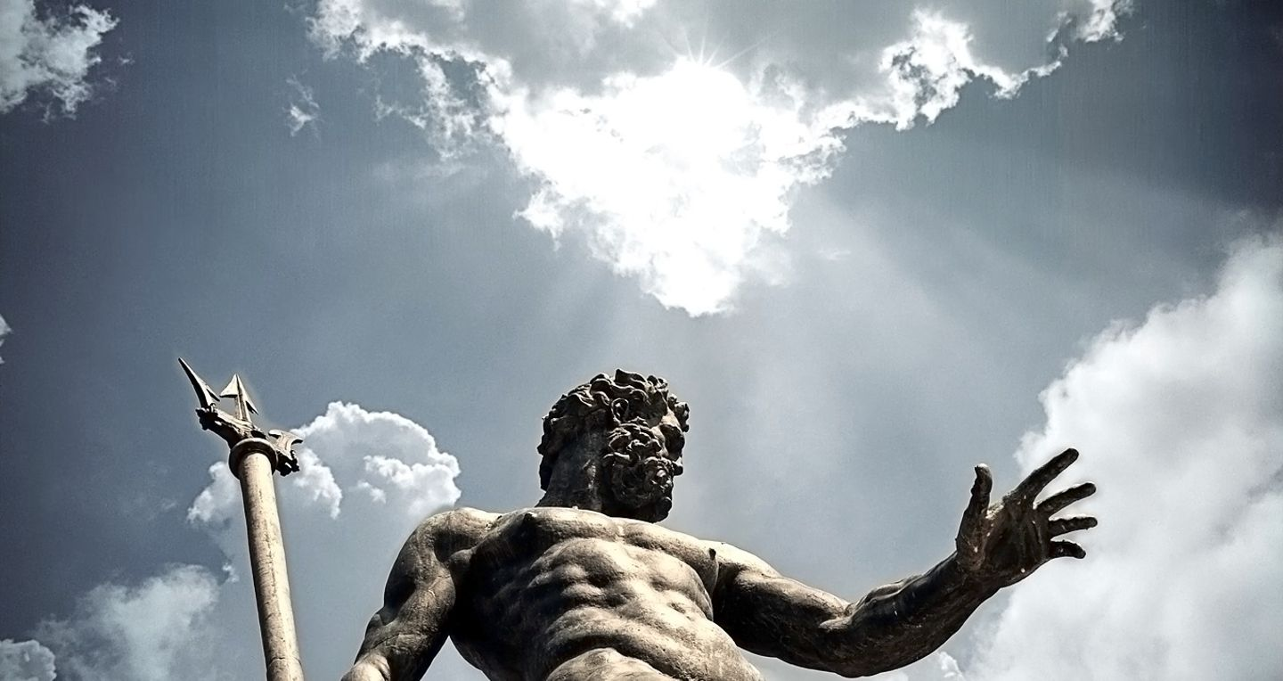
Neptune’s Trident that inspired the logo

Slide 34
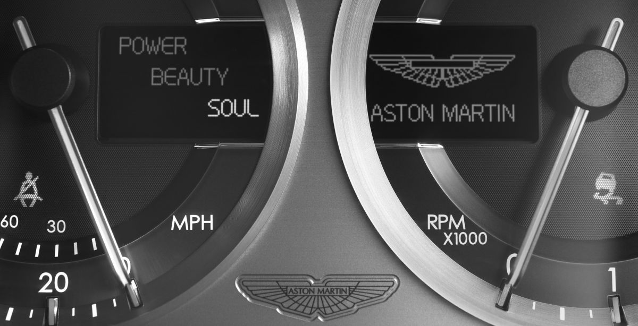
Aston Martin’s slogan

Slide 35
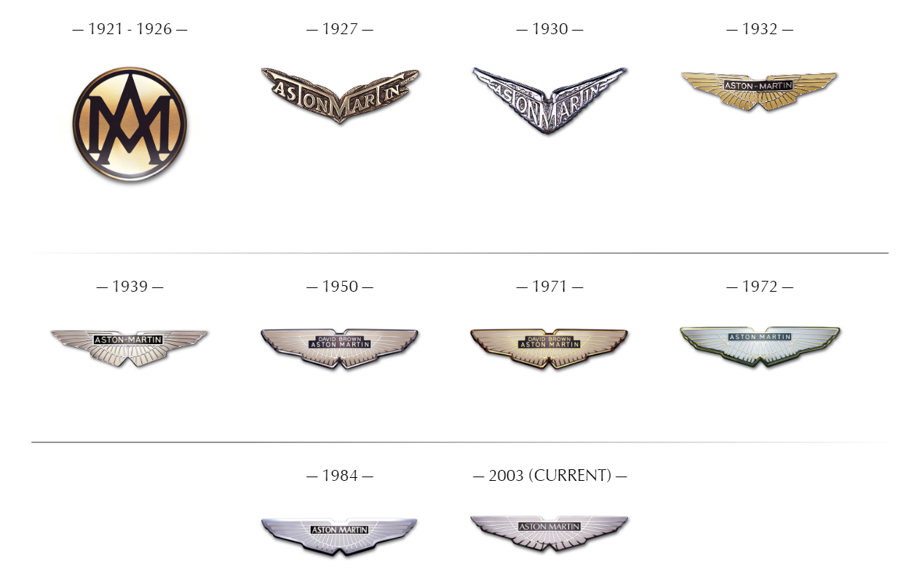
AM’s logo changes

Slide 36
CURRENT DEVELOPMENT

Slide 37
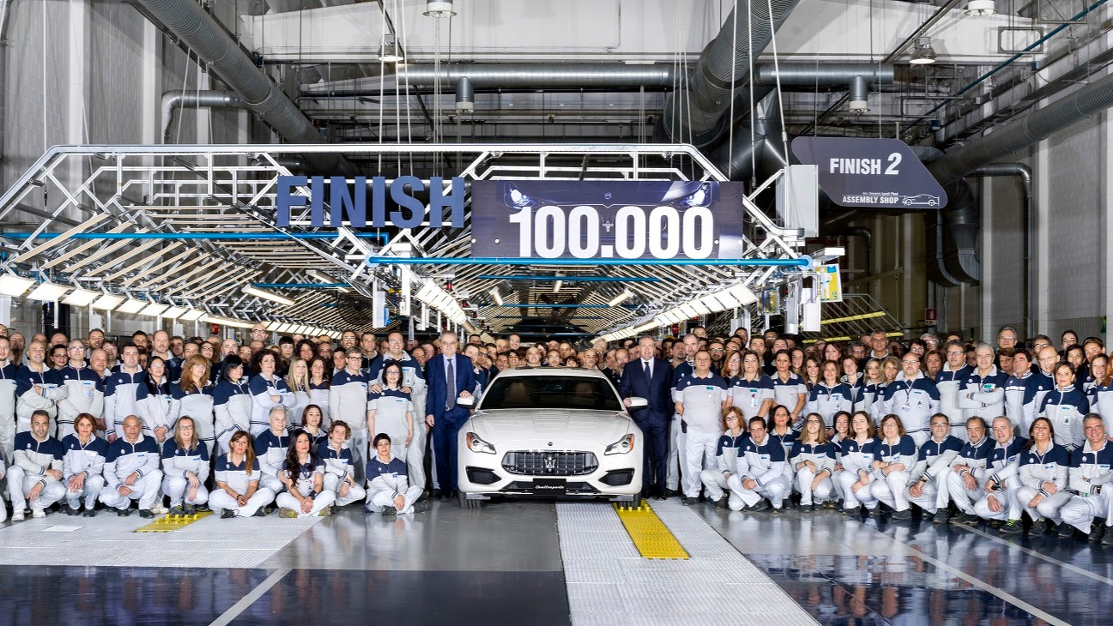
Maserati’s 100 000th car produced in 2017

Slide 38
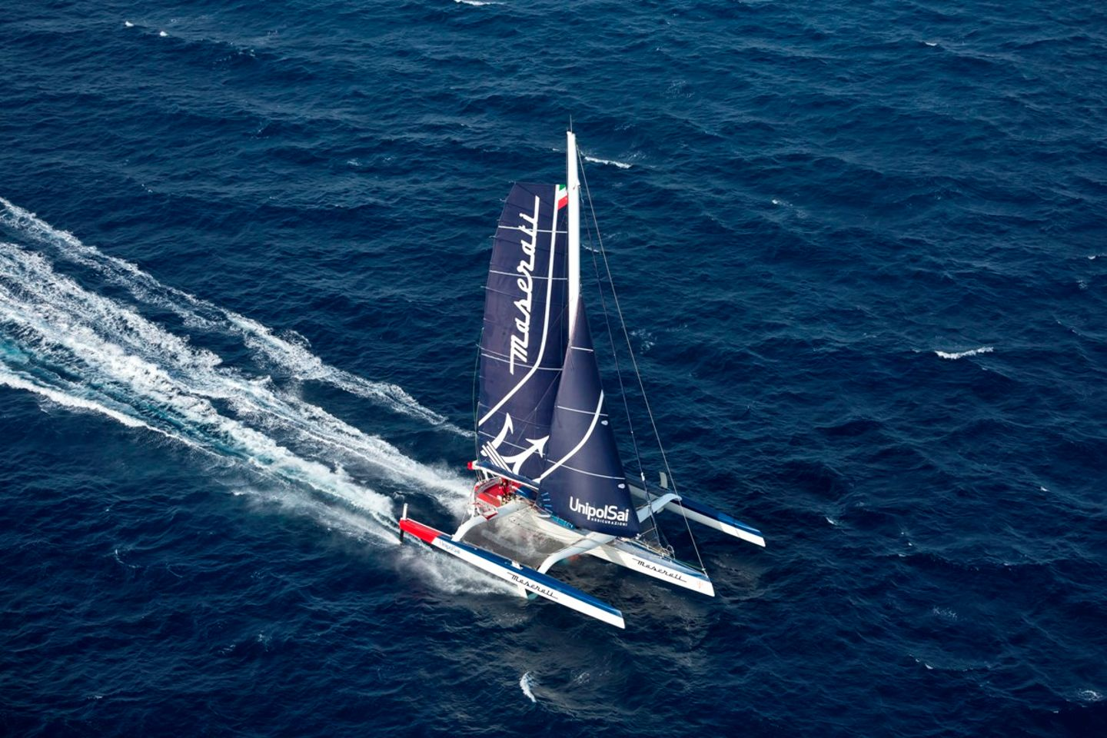
Maserati’s Multi70 yacht for its sailing team

Slide 39
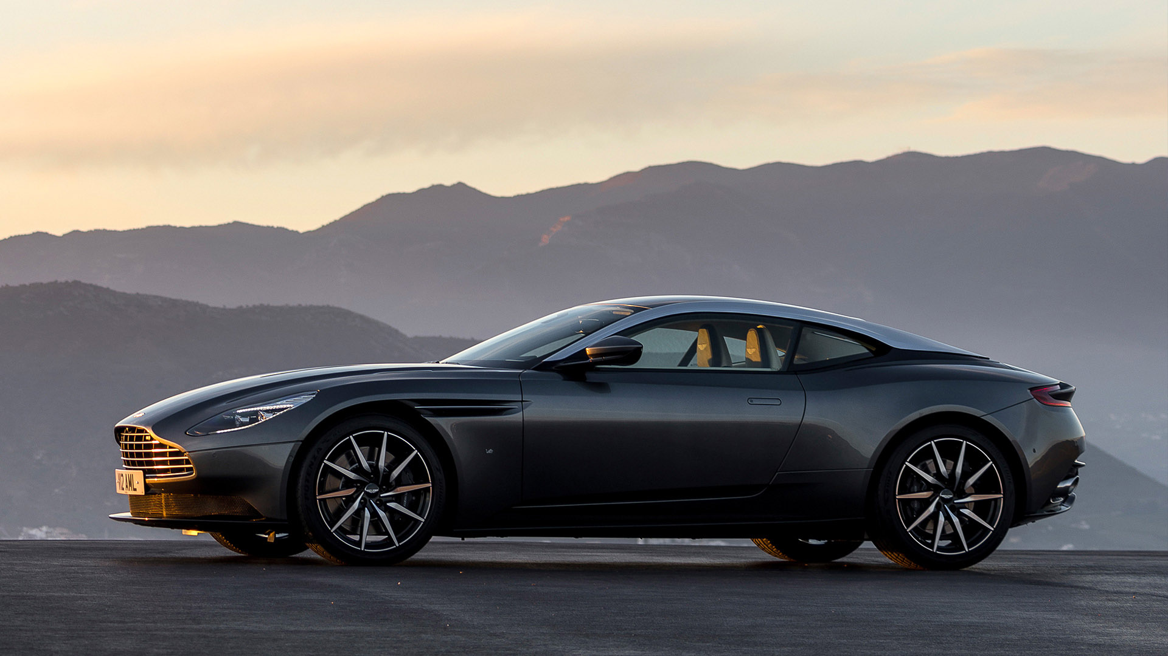
Aston Martin’s first all-new model for a decade, DB11, 2016

Slide 40
DB11 boosted AM’s car sales in 2016 for
75% 15 billiard rubles

Slide 41
2017, record nine-month result, revenues up
84% 45 billiard rubles

Slide 42
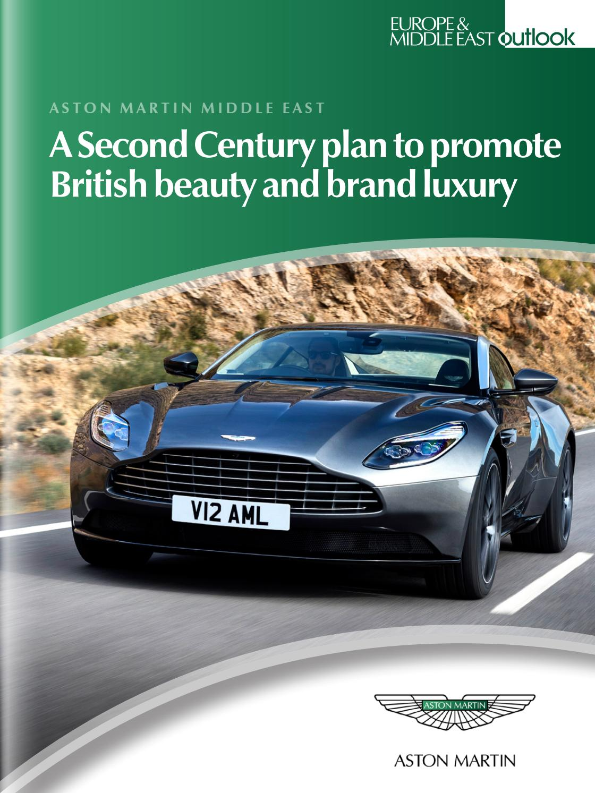

Slide 43
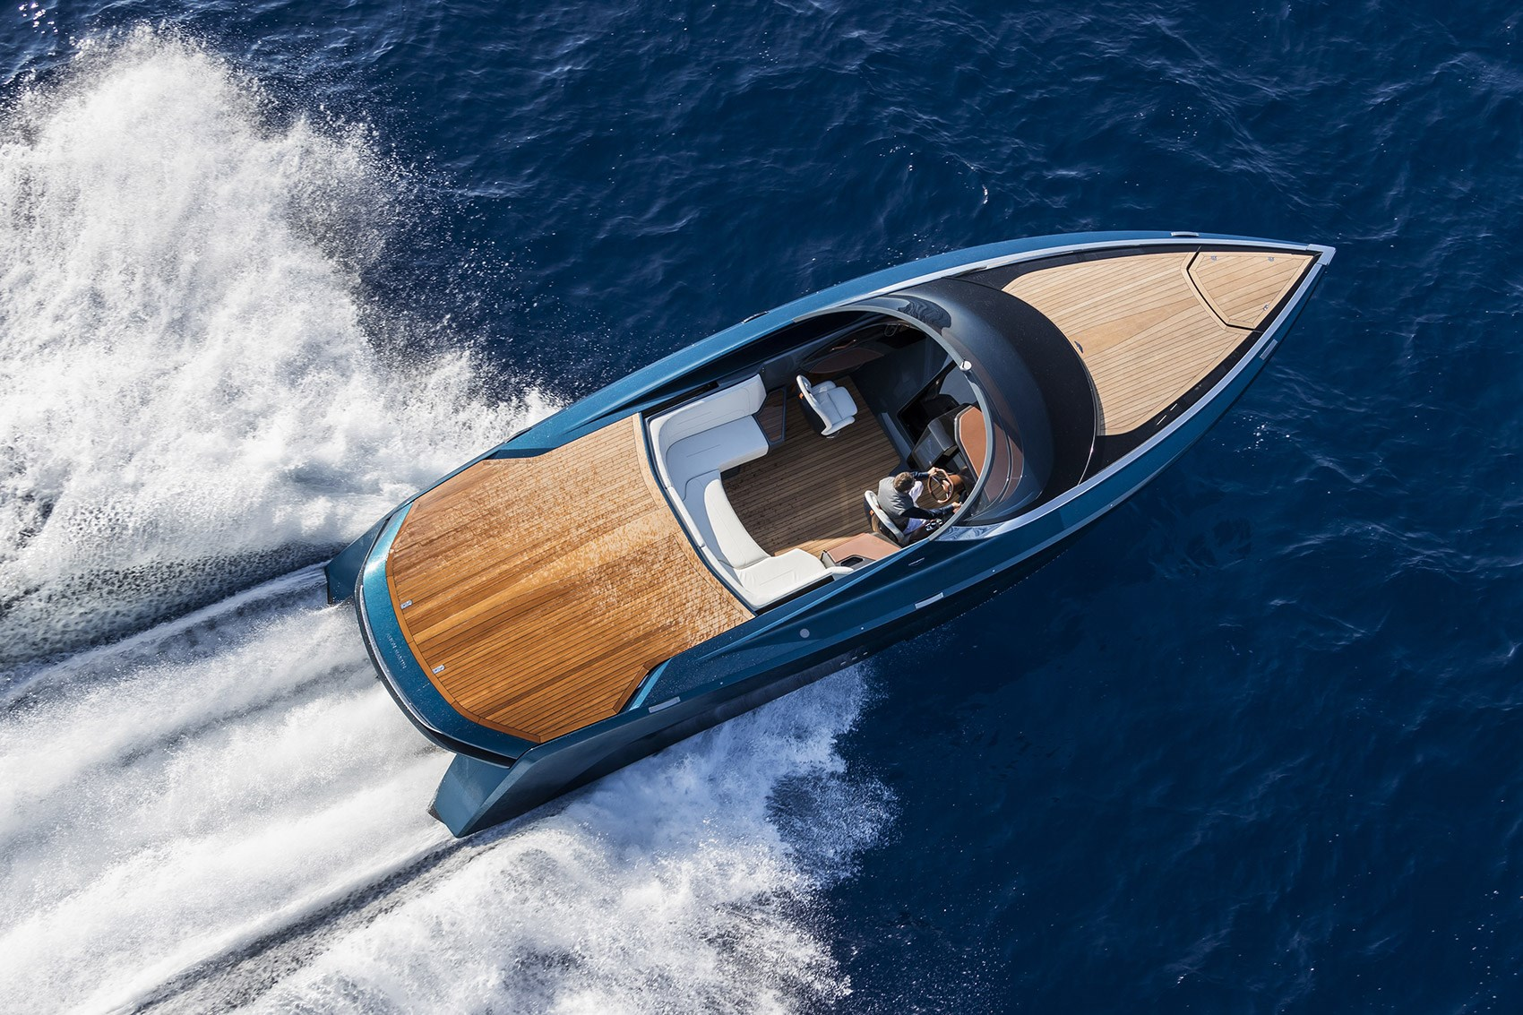
Aston Martin’s AM37 powerboat

Slide 44
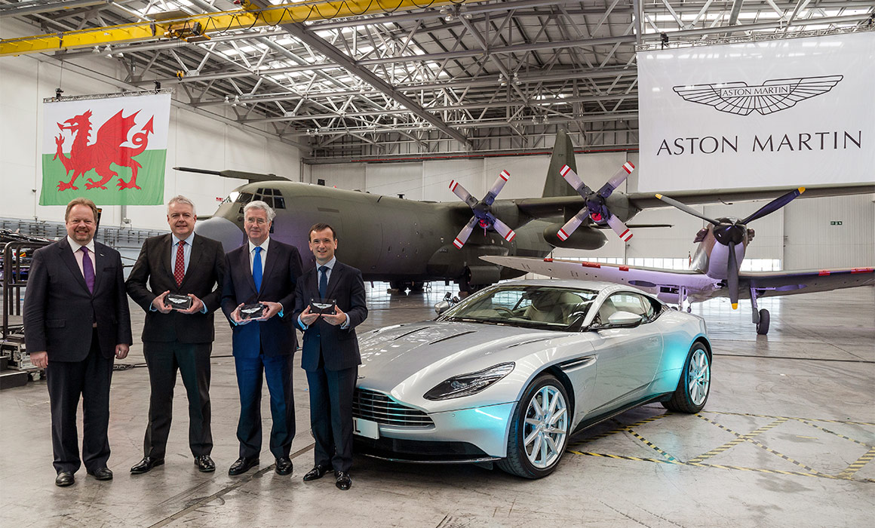
Aston Martin’s new plant in St Athan,

Slide 45
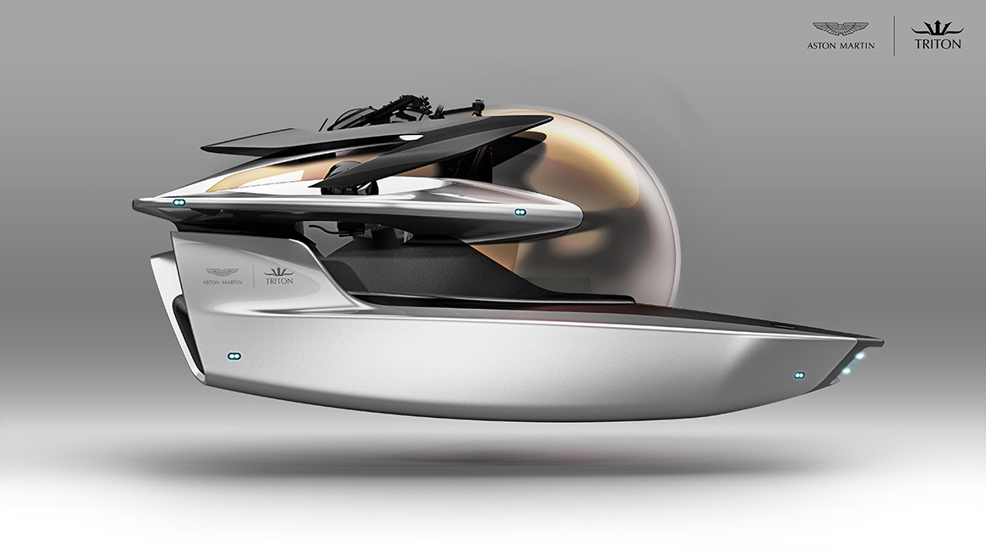
Aston Martin’s submarine Project Neptune

Slide 46

Aston Martin’s partnership with

Slide 47
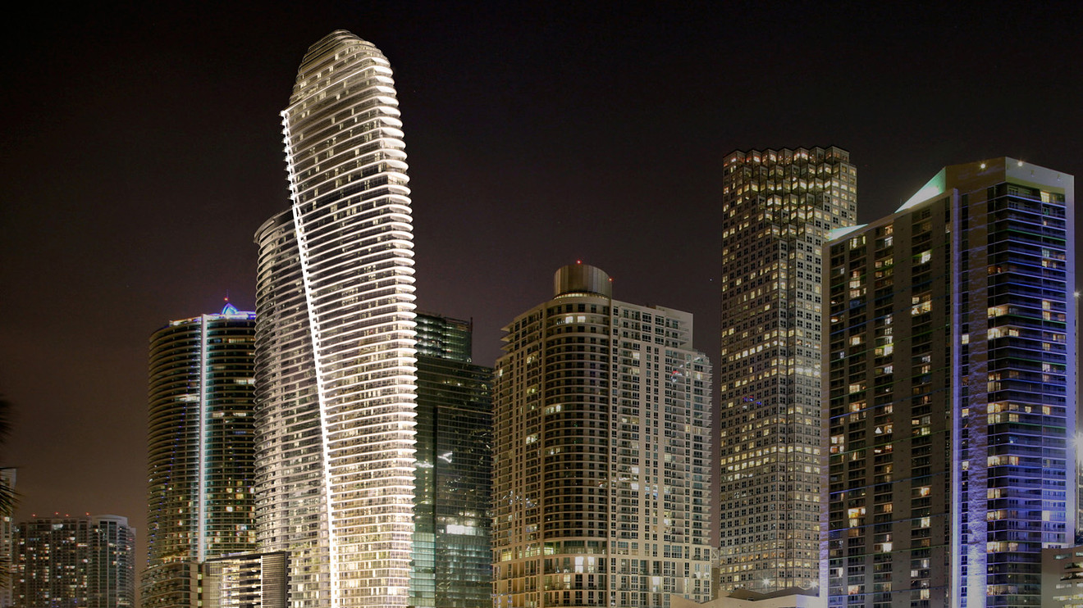
Aston Martin’s 66-storey tower in Miami

Slide 48
MARKETING

Slide 49
PRODUCT
MASERATI
ASTON MARTIN
HIGH QUALITY TIME CONSUMING HIGH-END
HIGH QUALITY TIME CONSUMING HIGH-END WIDER RANGE MORE COLLABS HIGHER PRODUCTION

Slide 50
PRICE
MASERATI
ASTON MARTIN
EXPENSIVE MIN 5 MILLION RUBLES
EXPENSIVE FROM 11,5 TO 240

Slide 51
PLACE
MASERATI
ASTON MARTIN
SHIPS WORLDWIDE THREE PLANTS
SHIPS WORLDWIDE FOCUS ON MIDEAST TWO PLANTS

Slide 52
PROMOTION
MASERATI
ASTON MARTIN
GOOD SERVICE MASS MEDIA CLOTHING
GOOD SERVICE MASS MEDIA CLOTHING TARGET EVENTS COLLABS BRAND EXPANDING
FAN KIDS

Slide 53
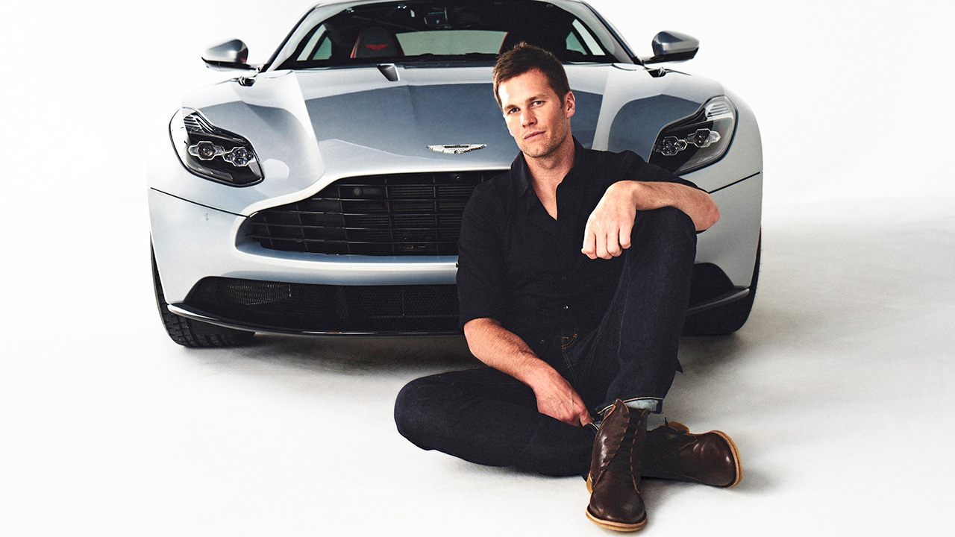
Aston Martin’s ambassador, Tom Brady

Slide 54

AM attract potential customers with experiential events

Slide 55
FUTURE

Slide 56
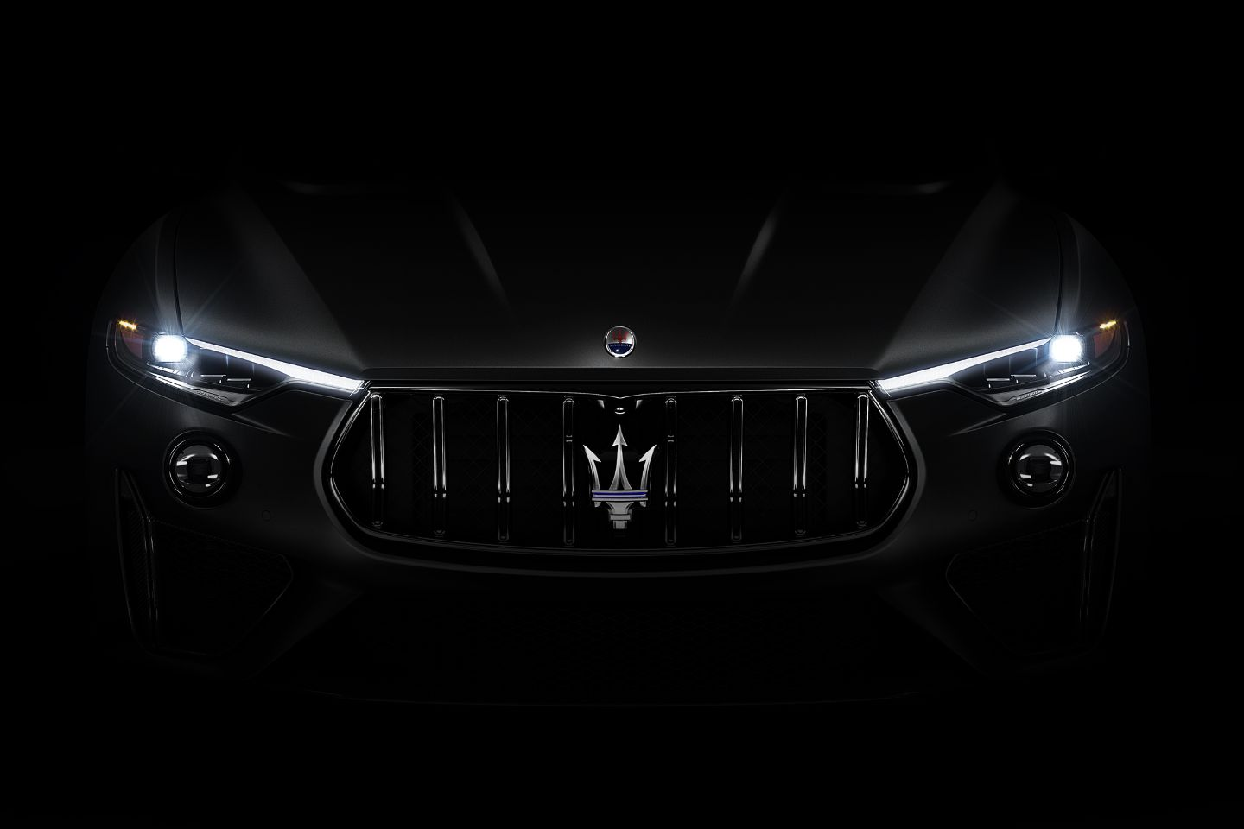
Maserati’s Levante Trofeo

Slide 57
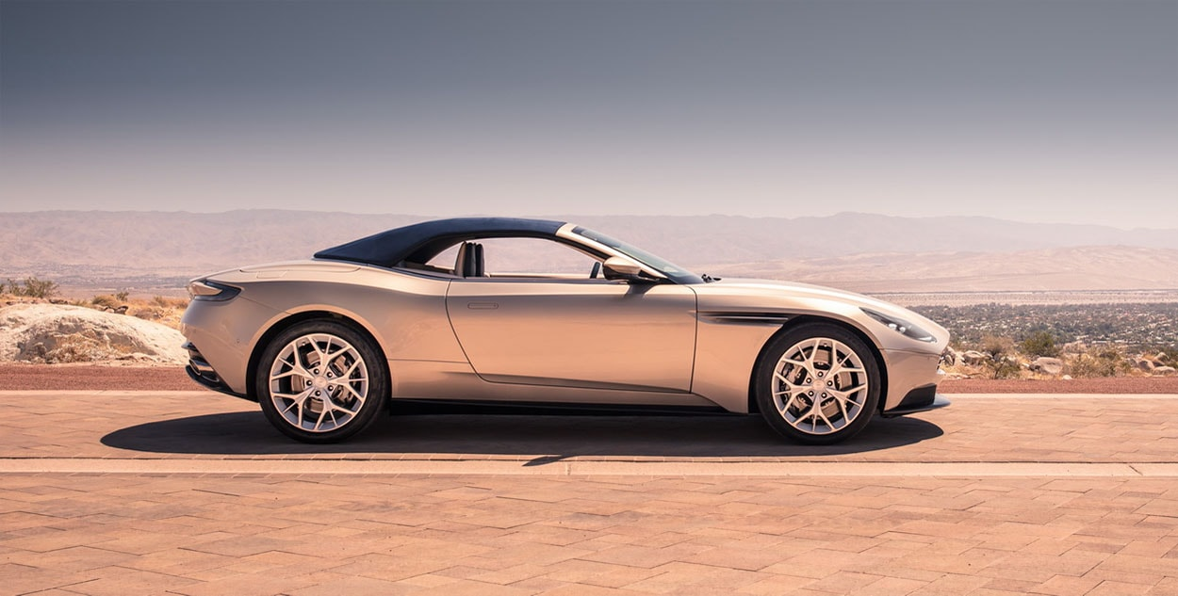
Aston Martin DB11 Volante, 2018

Slide 58
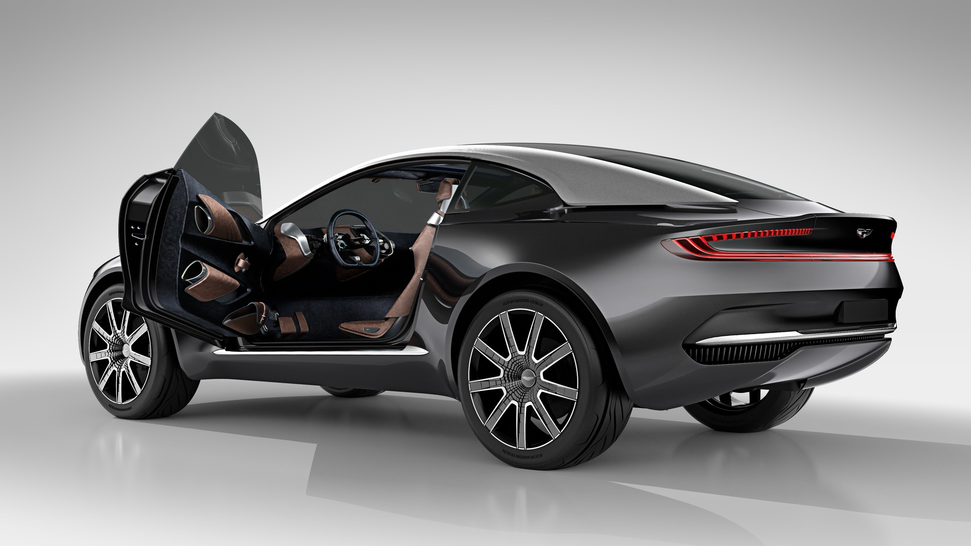
Aston Martin DBX, 2019

Slide 59
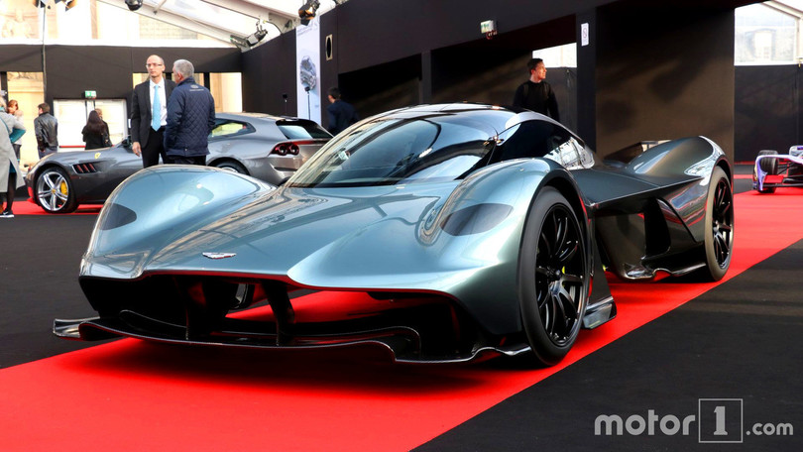
Aston Martin’s hypercar Valkyrie, 2019

Slide 60
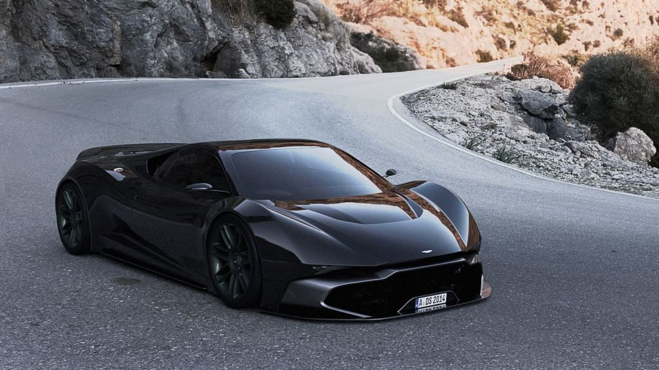
Aston Martin’s mid-engine super car, 2020

Slide 61
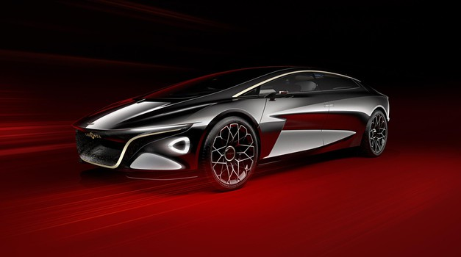
Aston Martin Lagonda, 2021-2022

Slide 62
Aston Martin DB12
?

Slide 63
CONCLUSION:
Maserati continues to follow the strategy of very expensive, “not for everyone”, steady and somewhat conservative high-end sport car maker

Slide 64
CONCLUSION:
Aston Martin decided to radically change its approach to the market and its objectives. Aston Martin has not only became the world’s fastest-growing automotive brand but succeeded to maintain and even improve its “luxurious must have” reputation.

Slide 65
Thank you

